Slide 1
UbZeb Creation
From 2D23D

Slide 2
Table of contents
01
04
02
05
03
06
Introduction
Solution provided by UbZeb
Company description
Marketing & sales strategy
Company Evaluation
Current Gaps in market

Slide 3
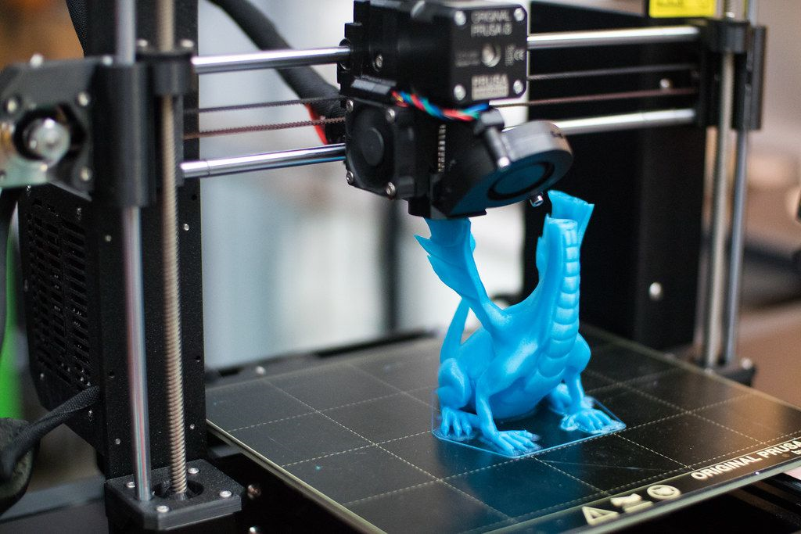
Introduction
UbZeb Creations is the result of a dynamic partnership between Ubaid and Jehanzeb, each holding a 50 percent share in the business. With extensive experience in 3D designing and printing, our journey began in our fifth semester, where we identified the significant market potential for selling 3D designs. Our commitment to pushing the boundaries of innovation in the 3D printing industry took a meaningful turn when a design we created for our computer lab garnered recognition from our teachers and was later implemented in our university. This success has been a driving force behind our passion for exploring the diverse applications of 3D printing technology.

Slide 4
Company description
01
Mission and Vision
Mission
Express Yourself: We help people showcase their unique style through personalized and creative 3D printing.
Your One-Stop Shop: Our goal is to be the first choice for personalized toys, unique decorations, and detailed 3D models.
Bring Ideas to Life: We make it easy for you to turn your imaginative ideas into real, touchable creations, boosting your satisfaction and creative joy.
Vision
Global Recognition: Become a globally recognized symbol of innovation, quality, and creativity in the 3D printing industry.
Trusted Brand: Build trust with customers by offering top-tier products and a reliable 3D printing experience.
Setting Standards: Be pioneers in setting and elevating industry standards, influencing the future of 3D printing practices.

Slide 5
02
Product offering
Toys
Fun and creative 3D-printed designs
Engaging for all ages, meant to bring joy
Unique blend of artistry and technical precision
Decorative Pieces
Unique and aesthetically pleasing
Each piece tells a visual story
Fusion of artistic craftsmanship and detailed 3D printing
Detailed 3D Models of Houses and Buildings
Complex and realistic for architectural visualization
Showcasing 3D printing's potential in capturing fine details
Customizable options to meet specific preferences and requirements

Slide 6
Role and Experties
01
02
UBAID-BIN-WARIS
Jehanzeb Khalid
Co-Founder and Technical Expert.
Brings technical expertise to the team, ensuring the viability and efficiency of 3D printing processes.
Manages the technical aspects of product development, including material selection and printer calibration.
Handles operational aspects of the business, ensuring smooth production workflows.
Co-Founder and 3D Designer
Specializes in creative 3D design, focusing on intricate and appealing models.
Oversees the artistic aspects of product development.
Involved in customer interactions and understanding market trends.

Slide 7
Current gaps in market
No Match in Stores
Limited Choices in Shops
Can't Imagine the Future House
Ever liked something online, like a cool toy or decoration, but couldn't find the same thing in stores? That's a bummer and leaves people unhappy with their shopping experience.
Traditional stores often don't have the variety people want. You might have a specific idea in mind, but the options in physical stores are limited, making it hard to find exactly what you're looking for.
When planning a new house, it's tough to imagine how it will really look. The usual ways of showing designs lack the details you need to make important decisions.

Slide 8
Solution provided by UbZeb
Get What You Love with 3D Printing
More Choices, Thanks to 3D Technology
See Your Future Home Clearly
We use 3D printing to make sure you can get the exact thing you fell in love with online. No more settling for something similar - you get what you want!
With 3D printing, we break free from the limitations of regular manufacturing. This means you have more options for toys and decorations, giving you a better chance to find something that fits your style perfectly
Our 3D models show you exactly how your new house will look. No more guessing – you get a realistic preview that helps you make better decisions and ensures you'll be happy with the result.

Slide 9
Unique Selling Proposition USP
USP
How it's Superior
We make 3D printing better for the
planet! We use recycled plastics, old 3D
printing mistakes, leftover industrial
stuff, and even reused bits of metal.
Choosing us is choosing the Earth. We care about
the environment, so we use materials that are
good for it. This not only reduces waste but also
helps the planet. You get top-notch products that
are eco-friendly and affordable. So, when you pick
us, you're making a smart choice for the Earth
and your wallet.

Slide 10
Creating 3D Printing Filament from Waste
Collection and Cleaning
Shredding and Filament Formation
Quality Control and Distribution
Gather waste materials like plastic items and failed prints.
Clean and prepare materials by removing contaminants.
Shred cleaned materials into small pieces.
Melt and shape the material through extrusion to form filament.
Cool and size the filament for 3D printing.
Test the filament for consistency and strength.
Wind the filament onto spools for packaging.
Package and distribute the recycled filament for 3D printing use.

Slide 11
Marketing & sales strategy
Target market
01
02
Sales process
Families seeking unique 3D-printed toys, home decor enthusiasts interested in personalized pieces, and architects/real estate professionals in need of accurate 3D models for visualization.
Make your 3D-printed products uniquely yours! Use our simple online tool to pick and choose exactly how you want them, adding a touch of fun and personal style to your creations.
03
04
Value proposition
Collaborations
Cost Effective, Eco Friendly Products and
Empowering customers to make environmentally conscious choices through informative content.
Work with popular influencers, toy stores, home decor shops, and architectural firms to make our 3D-printed goodies known to more people, reaching out to those who already love creative stuff.

Slide 12
6,000,000 Rs.
Earning of our last 6 month

Slide 13

Expences
500,000 Rs.
1,500,000 Rs.
800,000 Rs.
1,200,000 Rs.
Manafacturing cost
Marketing
Maintenance cost
The following pie chart show the expence in the company
Employee salary

Slide 14
Business plan timeline
Research and planning
Start- up phase
Growth phase
Partnership
Product expansion
Scaling phase
Innovation phase
Exit strategy planning

Slide 15

Company Evaluation
Seeking 5 lakh investment for 1% equity
Company valuation at 5 crore
Key achievements and market traction highlighted
Experienced team with industry expertise
Transparent use of funds for strategic growth

Slide 16
Thanks!
Do you have any questions?
ubzeb420@gmail.com
+92 301 9191 9191
Ubzeb.com

